Slide 1
Representing MAGE-TAB Files
Using OBI
Jie Zheng and Chris Stoeckert
Center for Bioinformatics
Department of Genetics, University of Pennsylvania

Slide 2
Goals
Adding MGED Ontology (MO) terms used in IDF and SDRF files into OBI (in progress)
Representing MAGE-TAB files using OBI

Slide 3
Outline
Background – MAGE-TAB files
Approach
Progress
Issues want to be discussed and solved in workshop (Experimental Design and Factors)

Slide 4
MAGE-TAB files
MAGE-TAB files are simple spreadsheet files which used to capture information about a microarray experiment:
  IDF file: describing an overview of the experiment, including the experimental design, experimental variables, protocols, contact details, and publication information
  SDRF file: describing samples, protocols used for each step in the experiment, hybridizations and links to the data files, eg. cel files
Typically contain some annotations using the MGED ontology (MO)

Slide 5
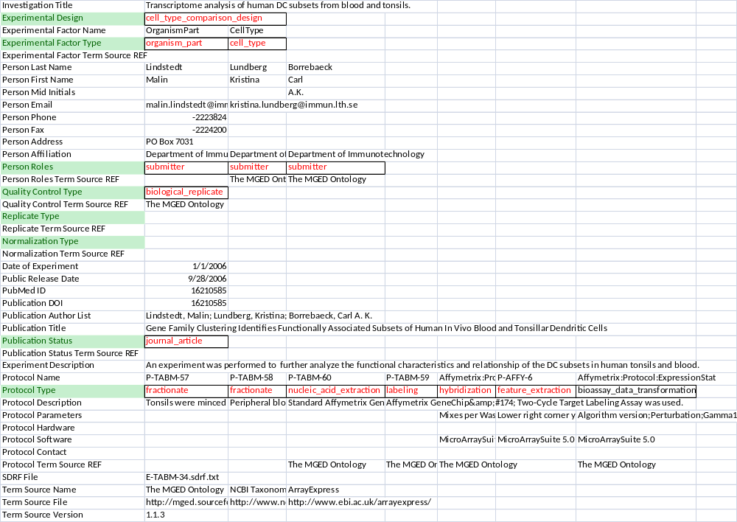
IDF file for E-TABM-34
Text in red are MO terms
Notes:
Fields that contains MO terms are highlighted in Green background, MO terms in Red

Slide 6
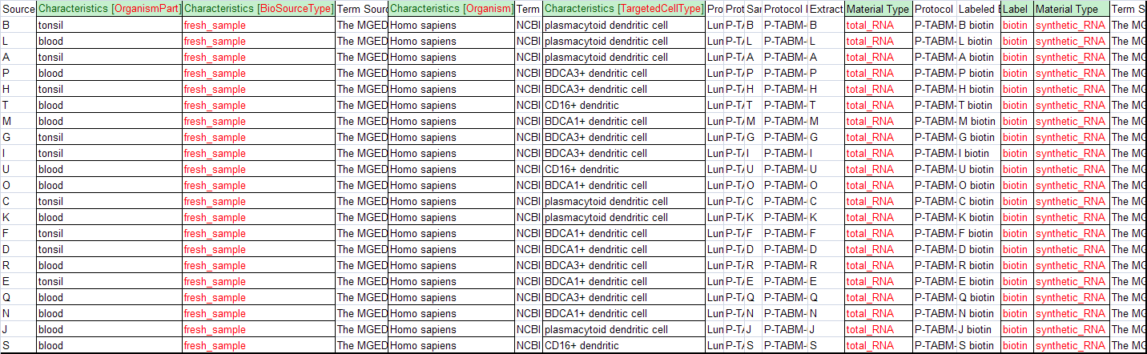
SDRF file for E-TABM-34
Text in red are MO terms
Fields highlighted in green contain ontology terms including MO terms

Slide 7
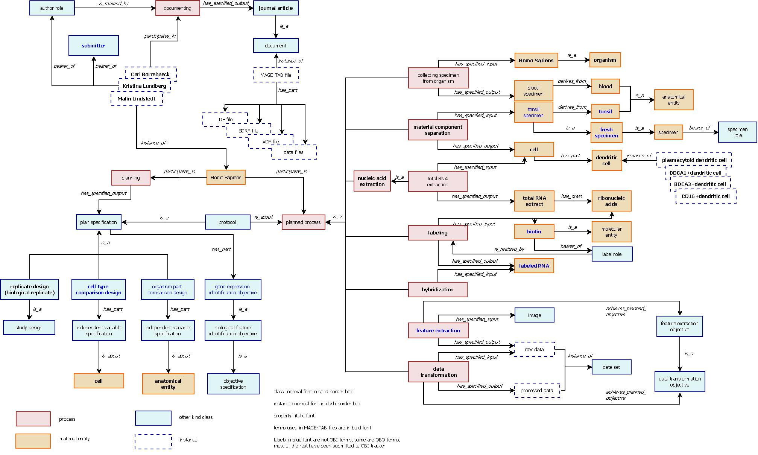
Representing E-TABM-34 using OBI
IDF file
SDRF file
Focus on where MO terms were used in E-TABM-34

Slide 8
Approach
Use case driven (9803 microarray experiments)
Focus on MO terms used in the MAGE-TAB files
Find out terms used for each annotation field that may contain MO terms or other ontology terms in IDF and SDRF files
Check whether the terms were in OBI already
Generate patterns for MO terms used in various annotation fields
Add/Import terms into OBI
Steps 1 and 2 have been done.

Slide 9
Fields used MO terms in SDRF file
  Material Type
  Label
  Unit
  Characteristics[BioSourceType]
  Other Characteristics
Most terms have been added into OBI
Terms have been submitted
Need to import from UO
Terms have been submitted
Pattern has been generated

Slide 10
Fields used MO terms in IDF file
Fields used MO terms in IDF file
  Experimental Design
  Experimental Factor
  Person Roles
  Quality Control Type
  Replicate Type
  Normalization Type
  Publication Status
  Protocol Type
Terms have been submitted
Pattern has been generated
Related to EFO
Many terms are in OBI

Slide 11
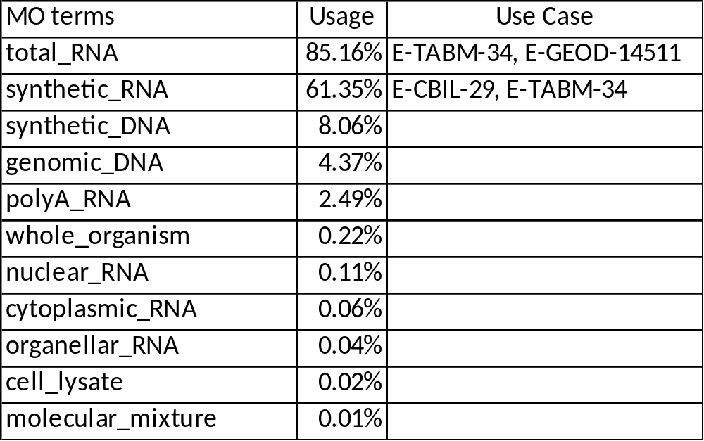
Material Types
https://sourceforge.net/tracker/index.php?func=detail&aid=2915152&group_id=177891&atid=886178
Notes:
Terms except in red have been added into OBI

Slide 12
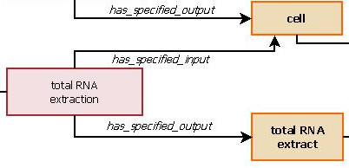
Material Types
Design Pattern
  A processed material which is the specified output of a planned process
E-TABM-34
‘total RNA extract’ is a processed material which is the specified output of
a ‘total RNA extraction’ process.
Notes:
All terms fit expect ‘whole_organism’ (used in 0.22% of experiments)
‘molecular mixture’ mainly chromatin (protein+DNA) used in Chip-chip experiments (binding_site_identification_design)
Over 95% ‘synthetic_DNA’ and ‘synthetic_RNA’ were used as the output of a labeling process
Less than 5% ‘synthetic_DNA’ used as the output of an amplification process, can use OBI ‘amplified DNA’

Slide 13
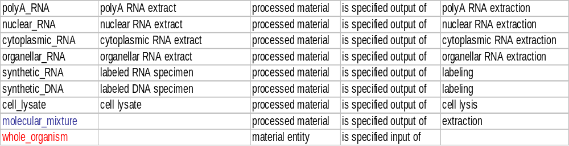
Material Types
  A processed material which is the specified output of a planned process
Notes:
whole_organism did not fit the pattern
Synthetic_RNA or _DNA were renamed as labeled RNA/DNA specimen because over 95% were
used as an output of labeling process
Generally, molecular_mixture referred to chromatin (protein+DNA)
need a more specific name to add into OBI
Notes:
All terms fit expect ‘whole_organism’ (used in 0.22% of experiments)
‘molecular mixture’ mainly chromatin (protein+DNA) used in Chip-chip experiments (binding_site_identification_design)
Over 95% ‘synthetic_DNA’ and ‘synthetic_RNA’ were used as the output of a labeling process
Less than 5% ‘synthetic_DNA’ used as the output of an amplification process, can use OBI ‘amplified DNA’

Slide 14
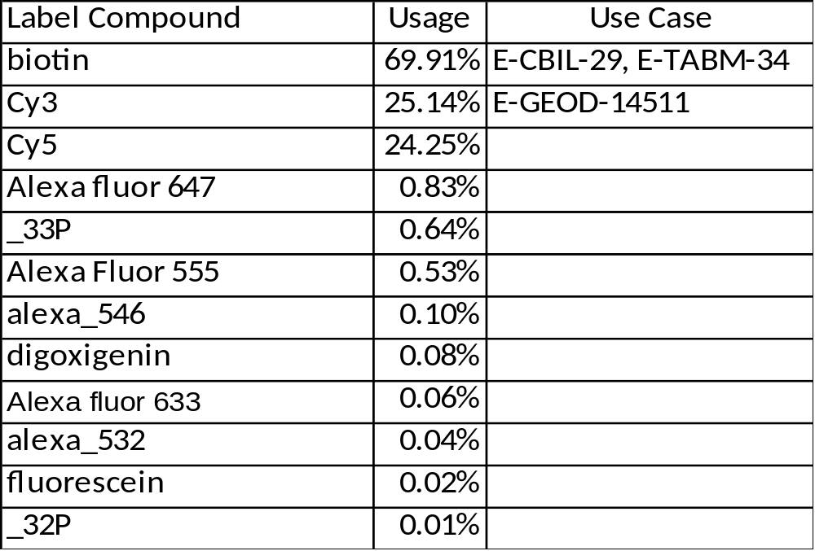
Labels
https://sourceforge.net/tracker/index.php?func=detail&aid=2955065&group_id=177891&atid=886178
Note: Not listed the labels used less than 0.1%, eg: hy3, hy5

Slide 15
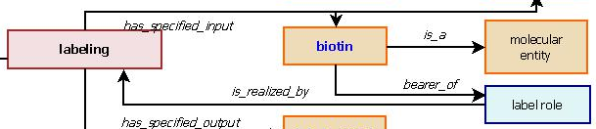
Labels
Design Pattern
  A molecular entity bearer of label role which is realized by a labeling process
E-TABM-34
‘biotin’ is a molecular entity bearer of ‘label role’ which is realized by a
‘labeling’ process.

Slide 16
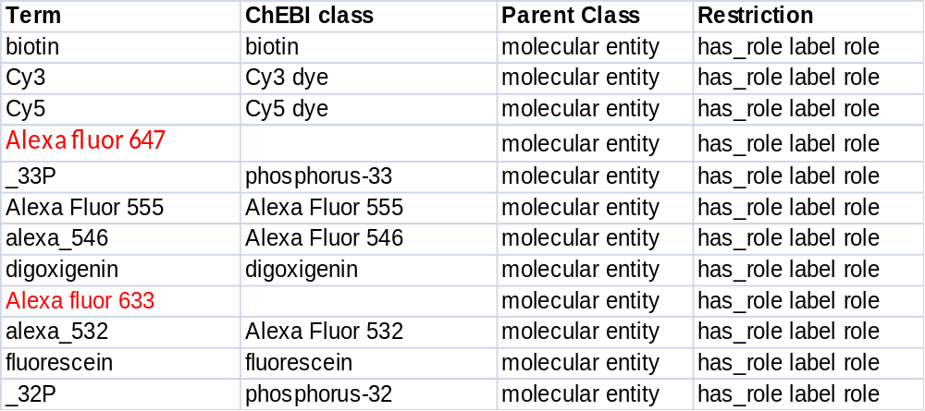
Labels
Notes:
Few compounds cannot be added to ChEBI because lack of structure information
    Alexa fluor 647 (usage: 0.83%)
    Alexa fluor 633 (usage: 0.06%)
Haven’t worked on some labels used less than 1% (eg: hy3, hy5 which usage is 0.1%)

Slide 17
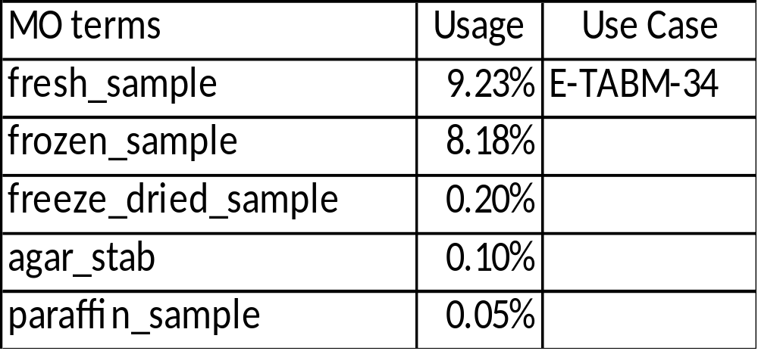
BioSourceType
https://sourceforge.net/tracker/?func=detail&aid=2955131&group_id=177891&atid=886178

Slide 18
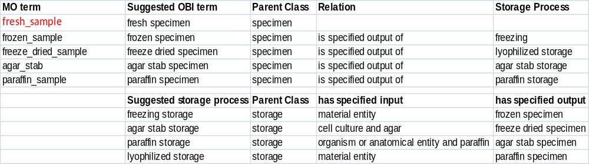
BioSourceType
Design Pattern
  is a specimen that is the output of a storage process with an objective of material maintenance
  Need to create corresponding storage process and specify its inputs and outputs
Note: All except ‘fresh specimen’ fit the pattern
Notes:
fresh_sample
------------
'specimen' define by a specimen creation process with specimen creation
objective which is to obtain and store a material entity for potential use
as an input during an investigation
Specimen creation process included both obtain and store processes.
Can we modify specimen creation process which is to obtain or to obtain
and store?
Fresh specimen is a specimen that is output of a specimen creation process
without storage.
Stored specimen is a specimen that is output of a specimen creation
process with storage.
Or define fresh specimen using disjoint (Chris' suggestion)
A fresh specimen is a specimen and is disjoint from stored specimen [
frozen specimen and agar stab and paraffin specimen and ..]
Question: In which stages, a processed material is a specimen? (refine the inputs/outputs of specimen creation process)
Extracted RNA/DNA are stored and used in the future for some experiments. Can we call these extracted RNA/DNA specimen?
Synthetic miRNA used for an experiment. Can we call it is specimen? (E-GEOD-14511)

Slide 19
Units
https://sourceforge.net/tracker/index.php?func=detail&aid=2896765&group_id=177891&atid=886178
UO terms, need to MIREOT into OBI
Question:
  MIREOT as instance???
  Just imported all needed units without indicating it is temperature or concentration unit …, add restriction to indicate where it can be used. eg. degree_C can only be used in the measurement data which measure temperature.
Notes:
How link measurement data to a quality or something else? (E-CBIL-29,E-MTAB-5)
Stem cells treated with Doxycycline – treated daily for 3 days (is_duration_of)
Yeast culture density at concentration – 0.2 O.D.
Yeast treated with oxidative stress(H2O2) – 15 minutes
Yeast grow at temperature – 37 degree C
MIREOT UO terms as instances into OBI

Slide 20
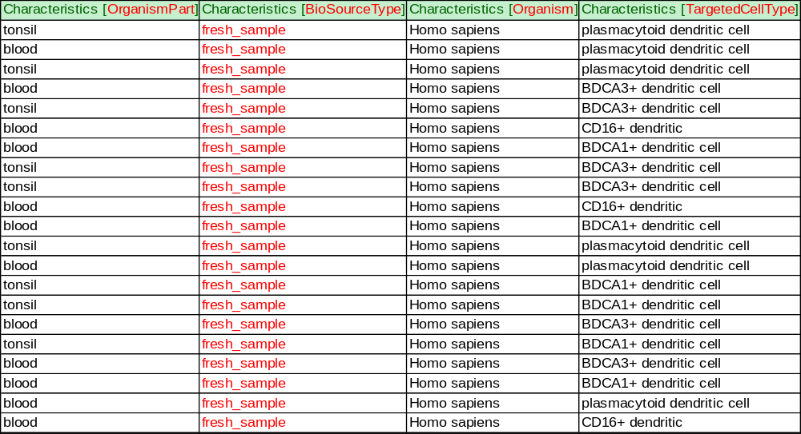
Characteristics – E-TABM-34

Slide 21
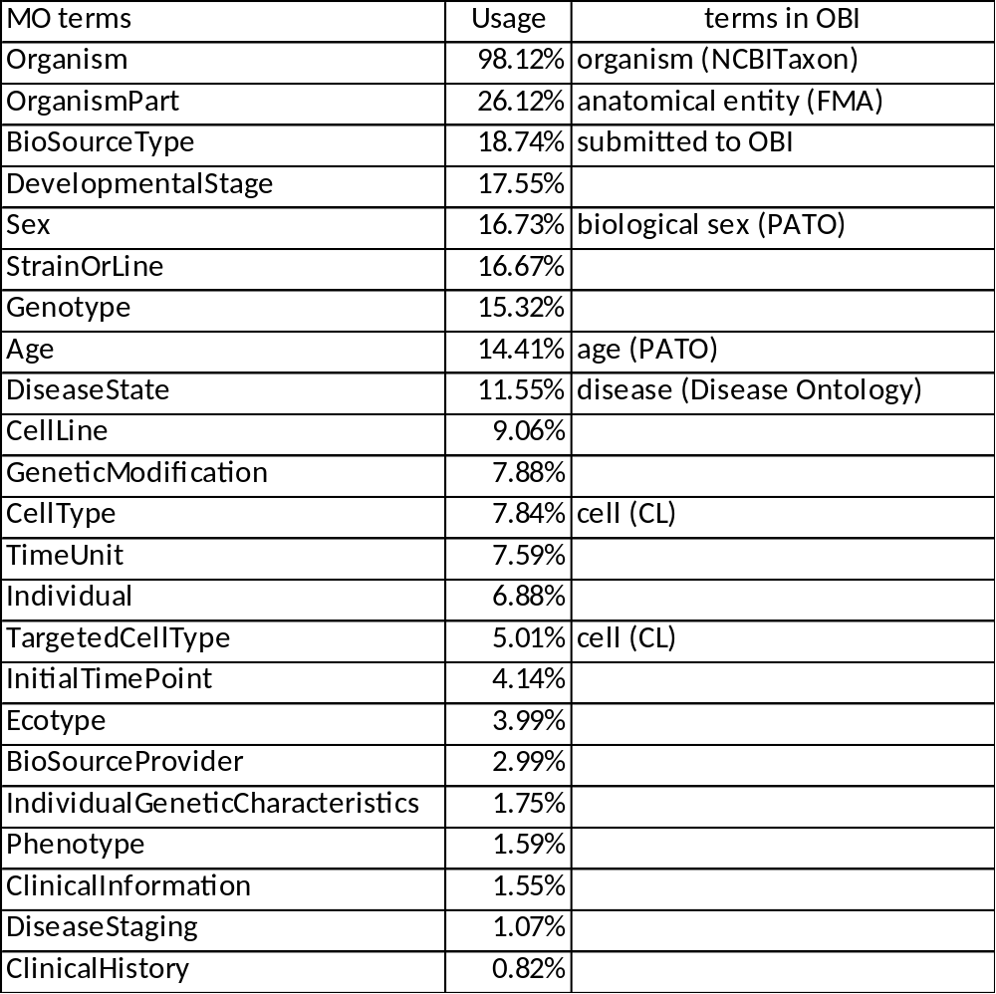
Characteristics
Category of characteristics are MO terms, values of it may not ontology terms
Some have been in OBI
Most are SO or PATO related terms
EFO deal with some of it

Slide 22
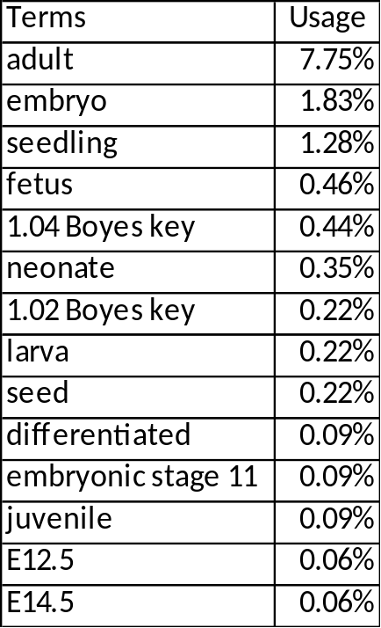
Values of DevelopmentalStage/Age
Some commonly used terms of Developmental Stage (not MO terms)
Value of Age is time measurement datum (number + time unit)

Slide 23
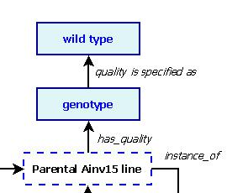
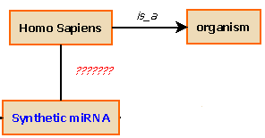
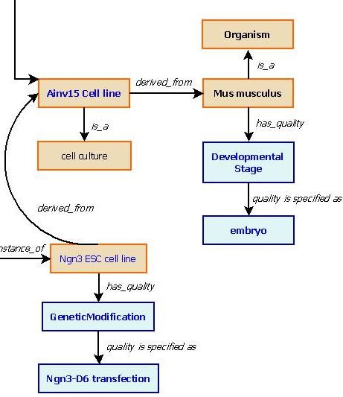
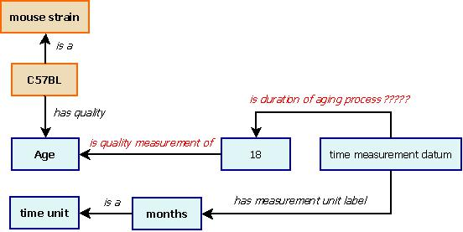
Characteristics
How to link specimen
with the characteristics?
How to deal SO related terms?
E-GEOD
-14511
How to link characteristics like age
to its measured value?
E-GEOD-6089
E-CBIL-29
Notes:
How to deal some SO related terms?
Genotype
IndividualGeneticCharacteristics
GeneticModification
How to link specimen with its characteristics?
How to link characteristics with its value?
eg. Age: 12 months
Some characteristics can be varied in an experiment which linked to Design Type. How to indicate it in OBI?

Slide 24
Experimental Design
Total 48 terms need to be added to OBI
The terms were categorized in 6 patterns

Slide 25
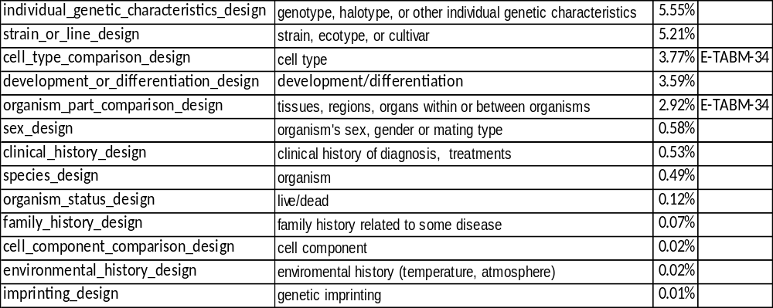
Experimental Design
biological characteristics of samples are independent variable of an experiment
Experimental Design Independent Variable Usage Use Case

Slide 26
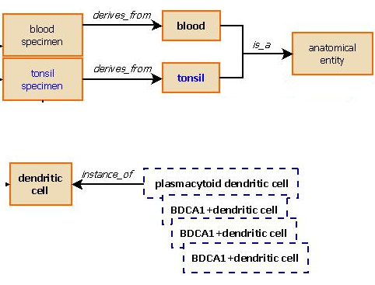
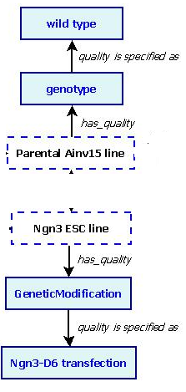
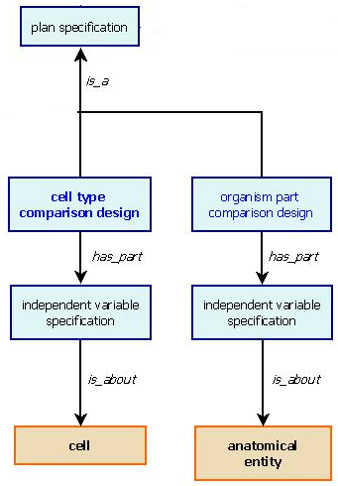
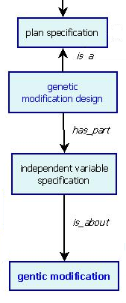
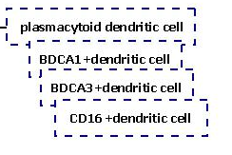
Use Cases
E-TABM-34
E-CBIL-29

Slide 27
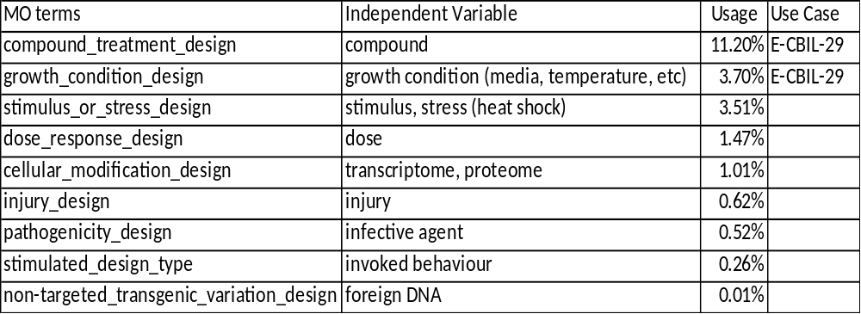
Experimental Design
Experiments varied in Protocols (= has protocol parameter)

Slide 28
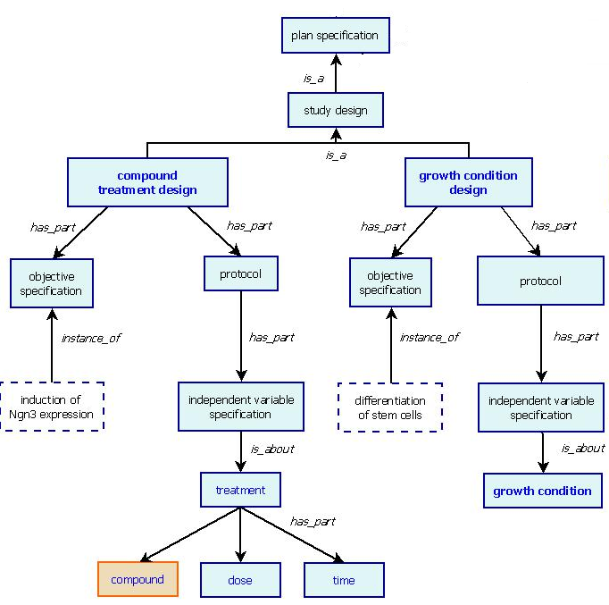
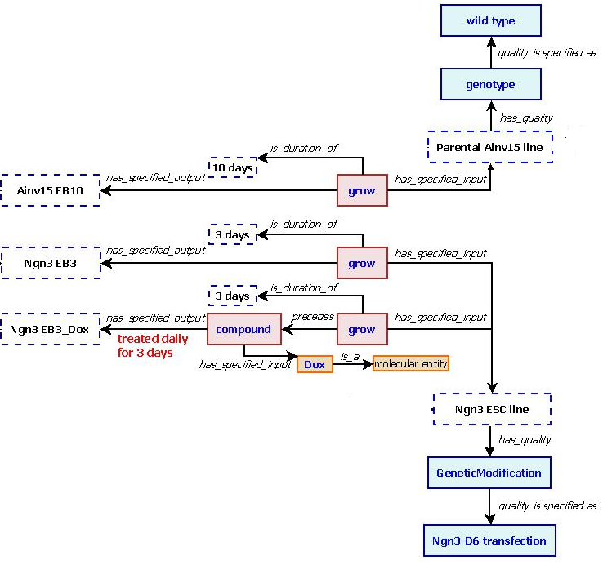
Use case – E-CBIL-29
Notes:
Media, duration

Slide 29
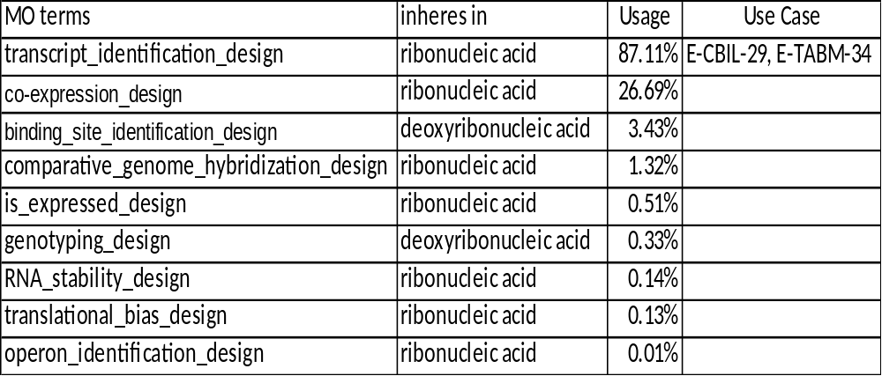
Experimental Design
Experiments aim to identify some biological properties (subclasses of OBI_0000015 biological feature identification)
Notes:
Concentration of mRNA in the sample

Slide 30
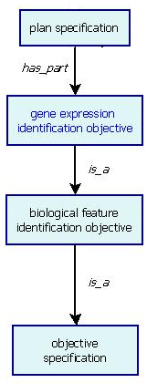
Use Cases
E-TABM-34
E-CBIL-29

Slide 31
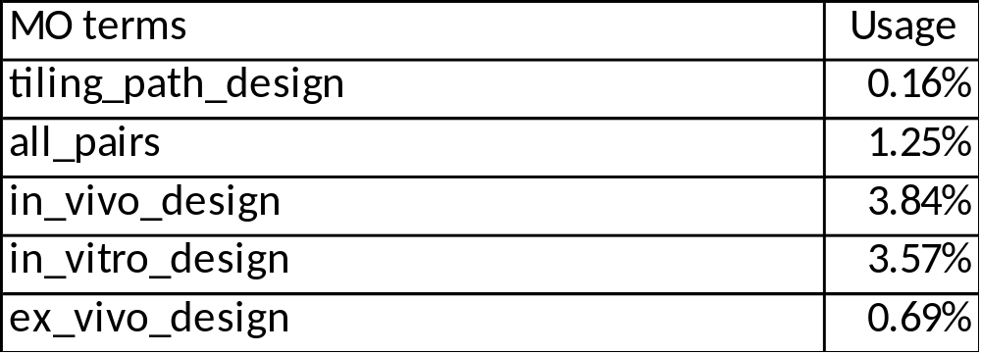
Experimental Design
Experimental design related to methodology design
(subclasses of OBI_0500000 study design)

Slide 32
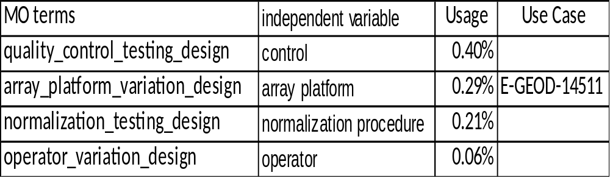
Experimental Design
Experimental design related to some methodologies testing
(has part objective specification - subclasses of OBI_0000208 methodology testing objective)

Slide 33
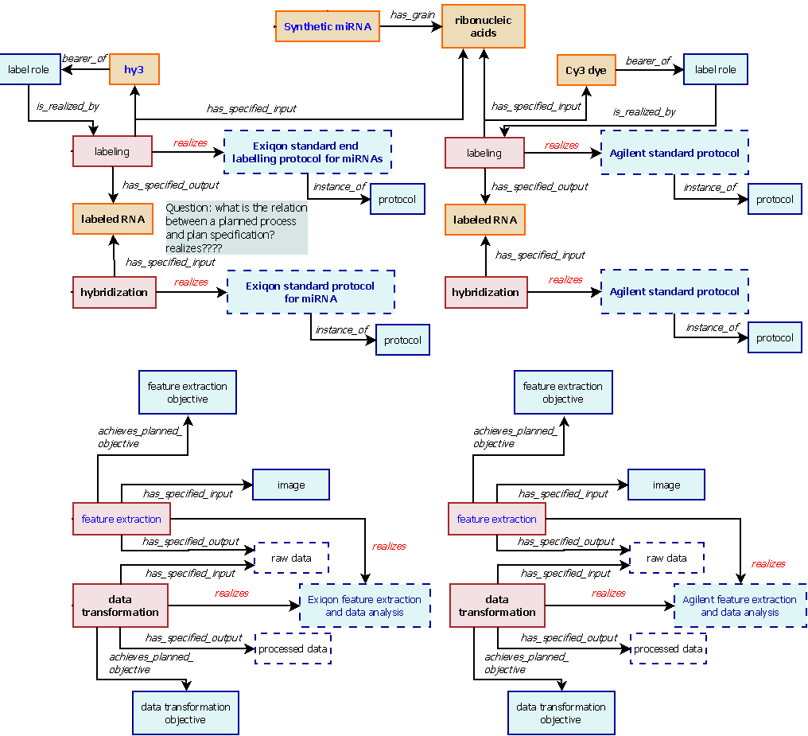
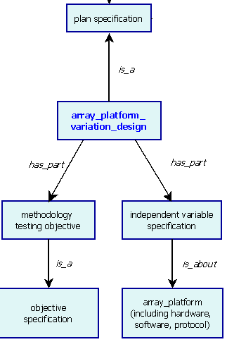
Use Case – E-GEOD-14511
Exiqon
Agilent

Slide 34
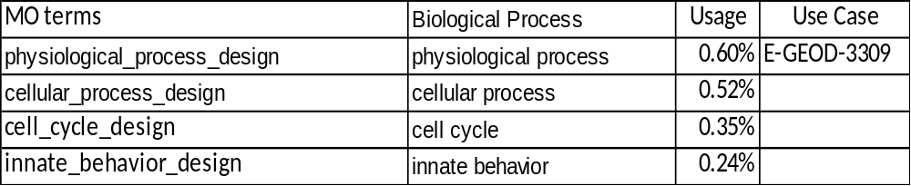
Experimental Design
Experiments investigate some biological processes

Slide 35
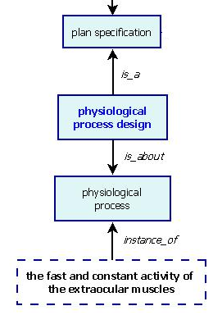
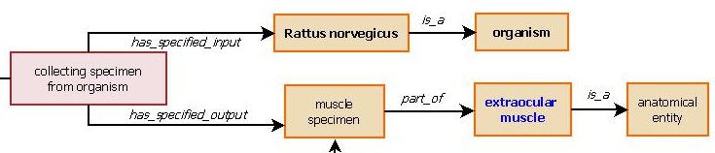
Use Case – E-GEOD-3309

Slide 36
Experimental Factor/Protocol Parameter
Linked to Experimental Design
It is independent variables of an experiment
Could be varied characteristics of a specimen
  eg. cell type_comparison_design
  In study E-TABM-34, cell type is an experimental factor (independent variable).
Could be protocol parameter
  eg. growth condition & compound treatment design
  In study E-CBIL-29, stem cells grew in different condition, treated with/without doxycycline.
  eg. Array platform variation design
  In study E-GEOD-14511, various protocols (including software and hardware) were used in labeling, hybridization, feature extraction, and data analysis.
How to link varied protocol parameters or specimen characteristics with plan specification and planned processes?

Slide 37
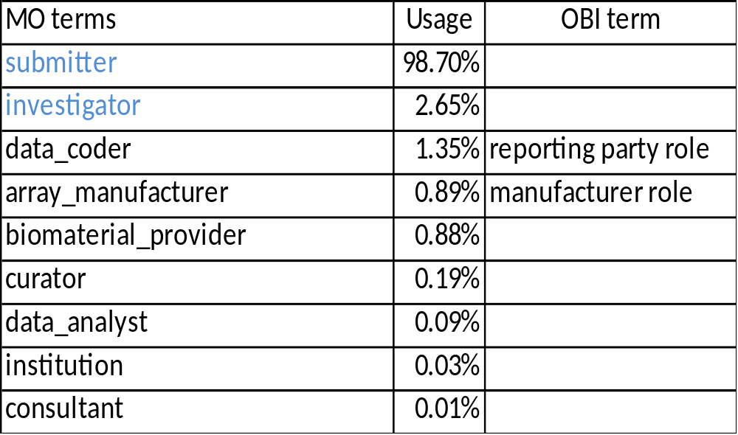
Person Roles
Notes:
Need to add submitter, investigator

Slide 38
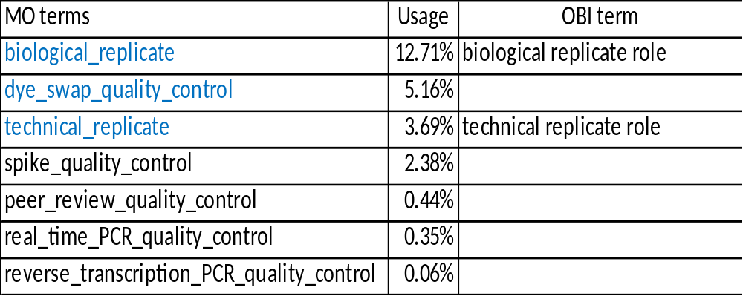
Quality Control Type & Replicate Type
Quality Control Type
Note: Terms in blue are also MO Replicate Type
How to indicate the processes that realize the replicate or control roles?

Slide 39
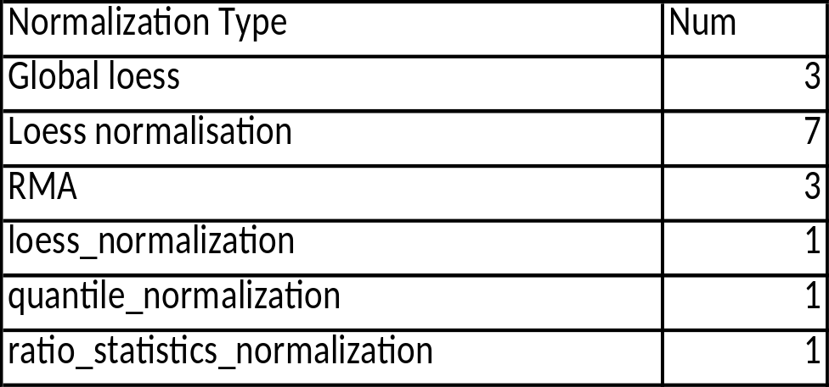
NormalizationType
Less than 20 experiments in a total of 9803 experiments indicated the normalization methods used for data analysis
OBI have many data transformation related terms, need to add ‘has data normalization objective’ could fit the terms used in MAGE-TAB files

Slide 40
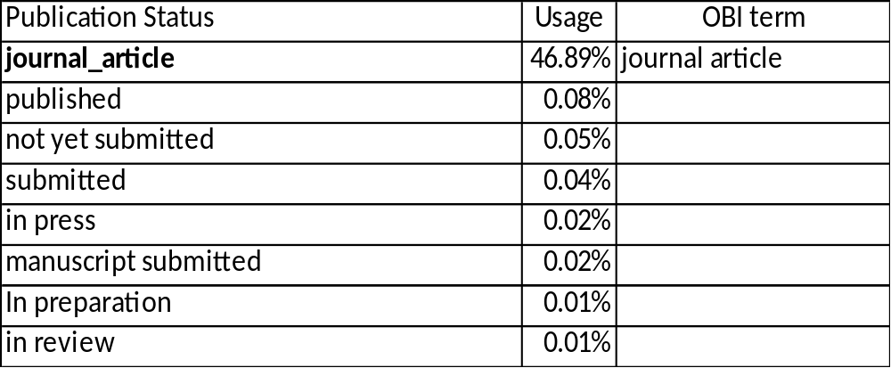
Publication Status
Only ‘journal_article’ is a MO term, in IAO already.

Slide 41
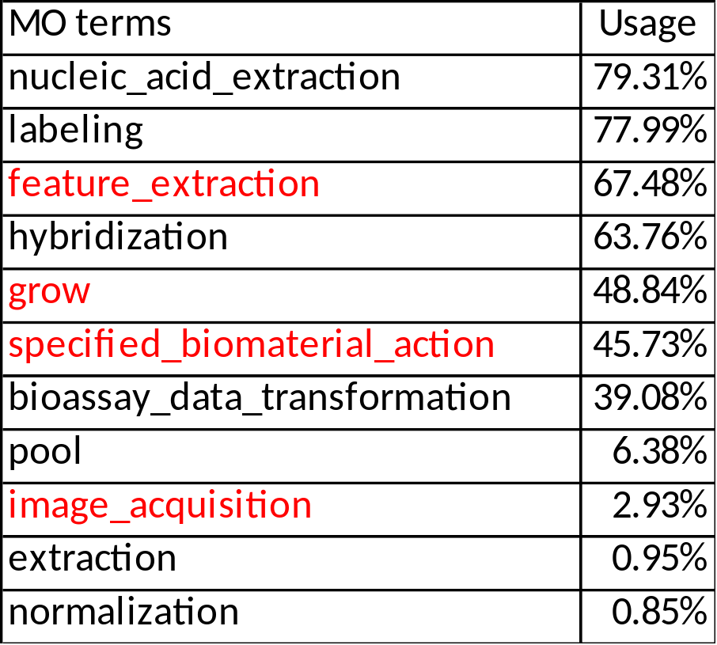
Protocol Types
Most terms are in OBI.
feature_extraction can be easily added in since OBI has ‘feature extraction objective’
specified_biomaterial_action can be replaced by more specific OBI planned process according to use cases.
Notes:
Terms in red not in OBI yet

Slide 42
Representing Experiments Using Other Technologies
Need to add information about Technology used for an experiment
For example:
The difference of RNA-seq experiment from the microarray experiment is the instruments and software used.
  Microarray (E-CBIL-29) – microarray platform (affymetrix, Affymetrix Fluidics Station 400, GC-RMA Quantification, Stratagene ArrayAssist Expression Software, etc.)
  Sequencing (E-MTAB-5) – sequencing platform (Illumina Genome Analyzer, BLAT, etc)
Notes:
Since MAGE-TAB files were used to describe a microarray experiment, it is no need to indicate which technology was used to perform the experiment.
For a sequencing experiment, the different of it from the microarray experiment is the instruments and software used.
Microarray – microarray platform (affymetrix array, microarray washing station, RMA plot, etc.)
Sequencing – sequencing platform (Illumina Genome Analyzer, Bowtie, TopHat, SAMtools, etc)
Add technology used for an experiment. The approch to represent a microarray experiment using OBI can apply to all other kinds of biomedical investigations.

Slide 43
THANK YOU
OBI Consortium

